Slide 1


Deep Dive into Exponential Distribution
The exponential distribution is a continuous probability distribution that describes the time between events in a Poisson process. Learn all about it in this engaging presentation.

Slide 2
Definition of Exponential Distribution
The exponential distribution models the time between events occurring independently at a constant average rate. It is defined by a single parameter, the rate λ, which represents the average number of events occurring per unit of time.

Slide 3
Probability Density Function
The probability density function (PDF) of the exponential distribution is given by f(x) = λ * e^(-λx), where x represents the time duration and e is the base of the natural logarithm. The PDF is widely used to calculate the probability of an event occurring within a specific time frame.

Slide 4
Properties and Formula
Memoryless Property
Formula
Expectation and Variance
The exponential distribution has the memoryless property, meaning that the probability of an event occurring in the next time interval is independent of how much time has already elapsed.
The cumulative distribution function (CDF) of the exponential distribution is expressed as F(x) = 1 - e^(-λx). This formula allows us to calculate the probability of an event occurring within a certain time period.
The expectation (mean) of the exponential distribution is E(X) = 1/λ, while the variance is Var(X) = 1/λ^2. These measures provide insights into the distribution's average behavior and dispersion.

Slide 5


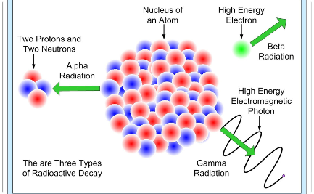
Applications
Queueing Theory
Reliability Engineering
Radiology
The exponential distribution is commonly used in queueing theory to model the interarrival time between customers in a waiting line, helping optimize service levels and minimize customer wait times.
Reliability engineers use the exponential distribution to assess the probability of failure for systems and components over time, aiding in preventive maintenance planning and system design improvements.
In radiology, the exponential distribution is employed to model the decay of radioactive isotopes and determine the half-life of radioisotopes used in nuclear medicine and radiation therapy.

Slide 6

Relationship with Poisson Processes
1
Poisson Process
A Poisson process is a stochastic process that models the occurrence of events over a continuous or discrete time interval. It is characterized by two parameters: λ, the average event rate, and t, the time duration.
2
Interarrival Time
The exponential distribution is used to model the interarrival time between events in a Poisson process. It assumes that events occur randomly and independently of each other.
3
Intuitive Connection
The exponential distribution and Poisson processes are closely related because the exponential distribution describes the waiting time between Poisson-distributed events, making them fundamental concepts in the theory of stochastic processes.

Slide 7

Real-Life Examples
1
Radioactive Decay
The exponential distribution is applicable to model the random decay of radioactive isotopes, such as the emission of alpha, beta, or gamma particles over time.
2
Arrival of Phone Calls
In call centers, the exponential distribution approximates the time between incoming phone calls, helping predict staffing needs and allocate resources effectively.
3
Failure of Electronic Components
Electronic component failure rates often follow the exponential distribution, enabling engineers to estimate the probability of failure over time and enhance product reliability.

